Slide 1

Aging Well, PA
Assessment Supervisor Orientation
September 2024

Slide 2
Objective:
To share guidance and resources with new and experienced supervisors and familiarize them with the tasks and responsibilities of the role.

Slide 3
Agenda
About AWP: Our Core Values & Operating Principles
AWP/AAA Agreements
  Assessor Quality Assurance
  Operational & Backup Plans
AWP Website
FED Basics for Supervisors
PIA Basics for Supervisors
Reports
  Invoices
  Quality Assurance/Self-Monitoring
Desk Reviews
Correctional Facility FEDS
Assessment Staff & PIA Users
Regional Conference Calls
Role of the QCSS
Contacts & Questions

Slide 4
About Aging Well, PA
Aging Well, PA was created as a subsidiary of the Pennsylvania Association of Area Agencies on Aging, P4A, to act as an extension promoting and supporting work that advances the ability of older people to live well. Aging Well PA does this by facilitating, coordinating, and providing services that support the provision of community services and supports for older adults in the Commonwealth.
Our organization operates under a set of core values and principles.

Slide 5
Our Core Values:
Integrity – We will do the right thing even when it’s not convenient to do so, and we will do it with consistency in what we think, say, and do.
Collaboration – We believe that collaboration provides more opportunities for success, greater diversity in ideas, and a deeper commitment to reaching goals. We work with others, not against others.
Quality Service – We believe we are most successful when we meet or exceed our own expectations and those of others. We always bring the best we have to offer in every situation.
Effectiveness – We believe that performing in a productive and proficient manner results in superior outcomes. When what we do is helpful and/or useful to others, our efforts have been effective.

Slide 6
Our Organizational Principles:
Think, speak and act from a positive place.
Recognize "we" is stronger than "I."
Know why you do what you do.
Be open to multiple possibilities.
Practice no-blame problem-solving.
Listen to understand.
Speak truthfully yet kindly.
Recognize, affirm, and support the good efforts and work of others.
Be clear about the expectation of continued improvement.
Ask for what you need.
Leave your ego at the door.
Keep commitments
* A full narrative for each organizational principle is included on the Aging Well website. P4A/Aging Well staff highlights a different principle in their email signature every month!

Slide 7
Getting Started:
As a supervisor, it is important to “know why we do what we do.” We highly encourage you to obtain a copy of your AAA’s Agreement with Aging Well, PA from your Director and read it.
Here are a few highlights of what is included in your AWP/AAA Agreement:
A Promise to Follow Laws, Rules, and Regulations | Operational Plans
HIPAA/Privacy & Confidentiality | Federal Language Requirements
Performance Standards | Participation in Quality & Compliance Activities
Timeframe Expectations | PIA Database
Assessor Training, ID Badges, & Clearances | Fees, Insurances, & Payment Provisions
CMS Assessor Qualifications | Record Retention

Slide 8
Assessor Quality Assurance:
Aging Well, PA is required to ensure that assessors meet specific standards as outlined in its grant agreement with the Department of Human Services. Therefore, we conduct assessor quality assurance activities on an annual basis.
Each January, your QCSS will request the following documentation for a specific assessment staff sample:
Minimum job qualifications approved by CMS (See Exhibit E in your AAA’s agreement with AWP). Acceptable documentation includes copies of college transcripts, diplomas, licenses, HR-approved resumes, Civil Service letters, etc.
Criminal background checks within past 5 years.
FBI clearances for employees who have been PA residents for less than two years.
Child abuse clearances, if obtained (Not required unless working directly with children).
Copies of ID badges that provide the employee and agency’s name.

Slide 9
Operational and Backup Plans:
As per the agreement with AWP, each AAA is required to have an Operational Plan.
  The contract language stipulates, “The agency must develop an operational plan that adequately addresses staffing issues that may arise and impact on the agency’s ability to maintain at minimum a 95% on-time completion rate for all assessments.”
Additionally, AWP requires each agency to have a Backup Plan to ensure coverage of all areas of responsibility related to the assessment process. AAAs must provide specific details on the Backup Plan Template to describe how they will cover the following topics:
  Assessor & supervisor tasks, appeals, desk reviews, invoices, training/certification, OBRA/PASRR, OU assignments, and other related duties.
  Primary and backup staff for each area of responsibility.
  Arrangements with neighboring AAAs for emergency backup coverage.

Slide 10
Operational and Backup Plans (Continued):
All supervisors need to know their agency’s backup plan for handling unexpected staff turnover, leaves of absence, and vacations.
AWP is required by contract to maintain assessment timeframes. As subcontractors of AWP, each AAA shares in this responsibility.
If you are the primary supervisor, please notify your QCSS of your backup for any extended period.
Keep in mind that Operational and Backup Plans are fluid documents.
Both should be updated annually at a minimum.
Or revised as needed when staffing changes or restructuring occurs.
Please email your QCSS a copy of your Operational and Backup Plans any time they are updated.

Slide 11
Safety Net
As previously mentioned, each AAA is responsible for ensuring AWP meets the assessment standards and timeframes outlined in our agreement with DHS. We need to maintain adequate assessor coverage in all areas of the state.
When unexpected staffing issues occur, we must be prepared to handle situations involving staff turnover, leaves of absences, vacations, pandemics, and emergency closures.
AWP maintains a list of AAAs willing to help neighboring AAAs with assessment-related duties.
If your agency anticipates needing help from another AAA, please reach out to AWP before the situation becomes a crisis resulting in late assessments. Your QCSS will assist you with activating the safety net.

Slide 12
Aging Well, PA Website
For your convenience, AWP posts guidance, FED & PIA resources, and multiple materials such as cheat sheets, flowcharts, quick reference guides, forms, and templates on our website for your review and download.
The AWP website can be accessed at www.agingwellpa.org.
Click on AWP Resources for AAAs
Do not enter a username
Enter the password: AWPFED2019
Under the category (FED, PIA, or Additional Resources), click on the listed resource to open it.
All assessment staff should be provided access to the website. The posted resources address the most common questions or issues. We respectfully ask assessment staff to check the website for information before emailing their QCSS.
Our website’s resources are intended for AAA/AWP use only and are not available to the public.

Slide 13
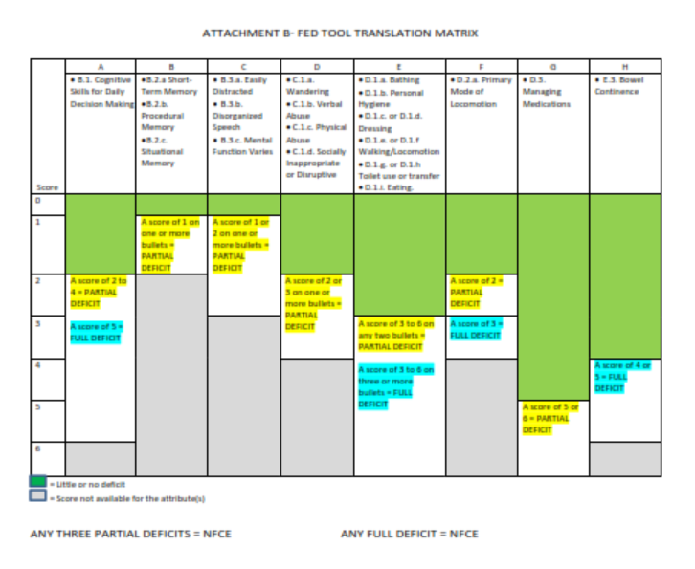
FED Basics: The FED Matrix
Assessment supervisors need to know which FED item scores result in an NFCE determination. The FED Matrix is the roadmap for understanding how the FED translator determines the outcome.
The Matrix is available for download on the AWP website.

Slide 14
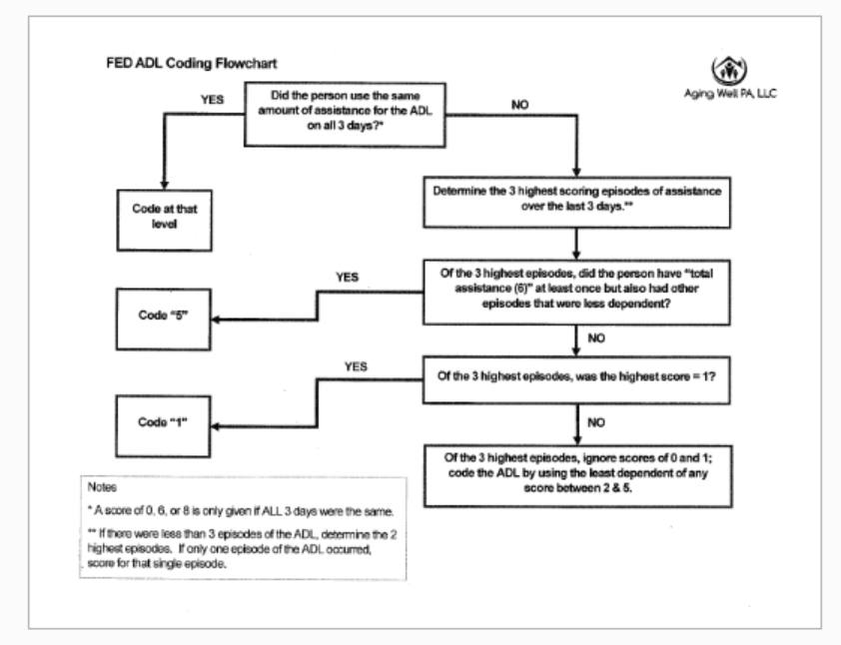
FED Basics: FED Flowchart
Supervisors must also be familiar with the FED Flowchart if an assessor has concerns about scoring ADL questions on a FED. The flowchart describes how to rate specific functional performance measures accurately.
The FED Flowchart is available for download on the AWP website.

Slide 15
FED Basics: Sharing FED Results with Applicants
When internet connectivity exists, the FED results are immediately available after completing the assessment. When this occurs, the assessor may verbally share the results of the FED. They may not, however, share a copy of the completed FED.
A copy of the FED is only available to applicants who appeal their final determination.
When verbally sharing the results with an applicant, it is essential to state that the determination generated by the FED is only one item that establishes clinical eligibility. For consistency across the Commonwealth, a uniform message must be provided when sharing FED results. The following script should be used.
  “Today’s FED assessment result is only one step in reaching a final eligibility determination for long-term care supports and services. When a final determination is made, you will receive written notification and instructions on how to appeal the final result if you disagree with it.”

Slide 16
FED Basics: Sharing FED Results (Continued)
ACT 150 Recertifications
If your agency receives a FED request from a service coordinator for an ACT 150 participant’s annual reassessment, you must complete the FED as requested.
You should also share a copy of the FED and the Assessment Results with the service coordinator. Generally, AWP does not provide copies of the FED, but this is an exception.
OLTL permitted us to share the FED with ACT 150 service coordinators because the assessment is needed for care planning.
Notes:
.

Slide 17
FED Basics: Medical Director Reviews
As indicated in OLTL Bulletin IEB-19-04, IAE-19-04,07-19-04:
The FED outcome is only one part of the clinical eligibility process. A physician must also certify NFCE determinations. When the certification submitted by the individual’s physician or the assessor’s opinion differs from the outcome of the FED process, a Department physician will review all available documentation to make the final determination.
Essentially, an MDR request is submitted when:
An MA-51 or MA-570 (PC) does not match the FED result for a Nursing Facility, Personal Care Home, or Dom Care FED.
When a FED result is NFI for waiver recertification, and the MA-570 (PC) disagrees.
When a FED Assessor disagrees with the FED result for ACT 150 Recertifications, PCH, Dom Care, or Nursing Facility cases.
Please see our website's detailed guidance related to the Medical Director Review process.

Slide 18
FED Basics: Medical Director Reviews
An MA-51 must be uploaded into the individual’s profile before requesting an MDR.
MA-51s attached in PIA for Medical Director Review purposes:
Must be valid and completed correctly (Signed by MD, DO, or OS; Include physician’s license number, filled out entirely, etc.)
If it states, “See List,” the attached documentation must include the medication list or referenced item.
The first MA-51 uploaded should be labeled as “unsigned by AAA.” After the MDR is done, sign the MA-51 and upload it as “signed by AAA.” Keep both copies in PIA.
If the MA-51 is incomplete or contains inaccurate information, you will receive a follow-up email from AWP requesting corrections.
MDRs can be requested by emailing AWP’s resource account at AAARequests@agingwellpa.org.

Slide 19

FED Basics: Withdrawing IEB FED Requests
The IEB Encryption box address, IEB-PAEncryptionBox@maximus.com, is
used when a FED requested by the IEB needs to be withdrawn. (For example, when you receive a new FED request from the IEB, and there is already a valid NF FED in PIA that can be released).
After the IEB withdraws a FED request, the AAA needs to open the FED and hit the “Withdraw” button on their end to remove it from Pending/In-Progress status.
Please do not email the IEB Encryption box for edits, general questions, or to request a consumer transfer to another AAA.
Any demographic edits for a PIA record created by the IEB or the Bulk Import should be sent to your QCSS.

Slide 20
FED Basics: Contacting the IEB
The following email address should be used when you require additional demographics from the IEB, such as an address or phone number, or have questions related to a specific referral.
PAIEBStakeholderInquiries@maximus.com
If you have not received a response from the IEB Stakeholder account within 24 hours, please forward a copy of the email to your QCSS. Your QCSS will follow up with the IEB on your behalf.

Slide 21
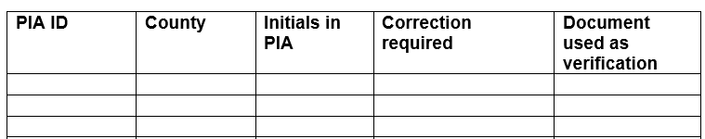
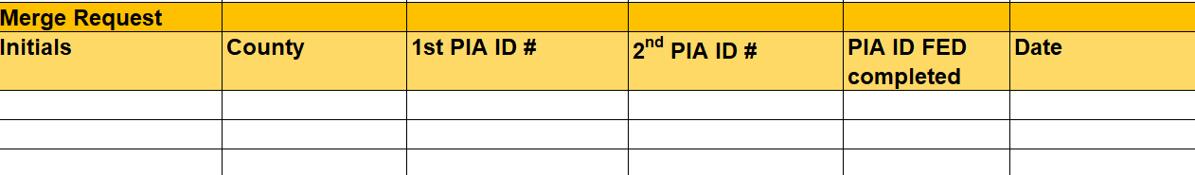
FED Basics: PIA Data Edits & Merges
If corrections are needed to consumer demographics (or placement county) in a profile created by the IEB or bulk import, and you cannot make edits, please send the requested changes to your QCSS.
If you find duplicate profiles in PIA for the same consumer, please provide your QCSS with the following information:

Slide 22
FED Basics: Appeals Process
The AAA Role in FED Appeals Training is available on the AWP LMS for all new and experienced assessment staff.
Here is a high-end overview of what a supervisor should know about the appeals process:
The AAA’s role during the appeal hearing is to be the subject matter expert (SME) to explain how the FED is administered, how it is scored, and the three-day look back.
  SMEs may provide the consumer with a copy of the FED if appealing and initial FED with the IEB for enrollment. For NFI Disenrollment appeals Aging Well provides any information.
  AAAs should not attempt to solve problems when the IEB, Attorneys, or consumers ask for help resolving cases on appeal.
  The AAA can offer suggestions only if specifically asked by the ALJ.

Slide 23
FED Basics: Appeals Process (Continued)
If the ALJ asks whether a reassessment would be an appropriate option, the SME may answer truthfully as they see fit.
If the SME is being pressured for a reassessment by other involved parties, they may indicate they are participating in the appeal as a SME, and their role is to explain how the FED is administered and scored.
SMEs should be prepared to provide hard copies of the FED, any PIA attachments, and the FED Matrix. The matrix is an essential part of explaining the appeal process.
If a pre-hearing conference is held without the ALJ present and enough new information is provided to warrant a new FED, the AAA can agree to reassess the individual, if appropriate. Without further information, the AAA does not have to agree to a new FED.
Ultimately, AWP does not want AAAs offering to do new assessments without being asked due to further information being provided.

Slide 24
FED Basics: Appeals Process (Continued)
Please ensure your AAA always has a SME ready to attend all requested appeal hearings, even expedited ones. It is essential to designate a backup SME to participate in appeals if a primary staff is unexpectedly absent (This should be included in your agency’s Backup Plan).
AWP understands that some AAAs may experience issues regarding appeal notifications, such as not being notified of the appeal or being notified at the last minute. We ask that you document specific appeal-related concerns and email them to your QCSS.
It is helpful for AWP to provide OLTL with case-specific information when issues occur. Please include the PIA ID number, an explanation of the problem, if it was resolved, and other pertinent information. (AWP does not expect or need to be notified every time there is an appeal.)
AWP maintains and provides the IEB with a list of appeal contact persons for each AAA. To ensure timely appeal notifications: please alert your QCSS when your contact persons change.

Slide 25

PIA Basics: PIA Roles & Tabs
The roles assigned to assessment staff in PIA determine their access to information and tabs in the system.
The three roles available to AAA staff are Supervisor, Assessor, and Admin OU.
The Tabs associated with each role in PIA are:
    Supervisor- Home, People, Assignments, My List, Alerts, and Reports
    Assessor- Home, People, My Lists, and Alerts
    Admin OU- Home and Alerts
*Email your QCSS if staff needs role changes.

Slide 26
PIA Basics: Organizational Unit Assignments
Tips for Transferring an Individual to Another AAA in PIA
Here is how OU transfers for individuals between AAAs should be handled:
  FIRST, unassign the individual from the assessor in PIA.
  Update the individual’s address and phone number in PIA, if applicable.
  Transfer the individual to the other AAA. The path to follow in PIA is:
    Care Management→ Organizational Unit→ Create New → Enter OU and Effective Date→ Submit.
  Open the PIA Transfer Contact List directly from the AWP Website and click on AAA’s name. Hyperlinks have been added to the list. By clicking on the AAA name, a new email addressed to all AAA recipients will appear. If a link is not working or contains an incorrect email, please notify AWP. It is essential that you tell your QCSS if your designated contacts change.
  After changing the OU, promptly email the receiving AAA to notify them of the transfer. If you do not receive a response, follow up with a phone call.

Slide 27
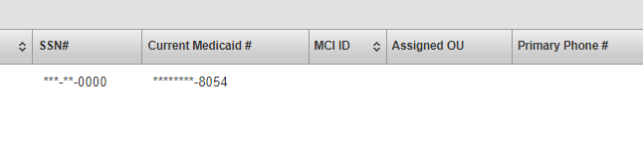
PIA Basics: Organizational Unit Assignments
To request access to an individual’s profile with no active AAA OU listed:
  Email your request along with the individual’s initials and PIA ID to AWP’s resource account at AAARequests@agingwellpa.org.
  If you do not receive a response within 2 – 3 hours, email your QCSS.
*****0000
When an active AAA OU is not assigned, no AAA name will appear in the search results for the person. You may see an MCO assigned, but the AAA name will be missing.

Slide 28
PIA Basics: Reports
At a minimum, it is imperative to run reports in PIA a few times per week to ensure all IEB referrals are received, assessments are submitted or withdrawn, inappropriate late excuses are identified and addressed, and invoices are completed accurately.
The essential reports to run are:
  Applicant Applied or FED Completion Report
  FED and PASRR Completion Report
  Desk Review Detail Report
  The Excuse Reports
Specific details for each report will be provided on the following slides. Using the reports for self-monitoring will also be covered.
As you move through the report slides, keep in mind the following:
  The Summary Reports pull the data based on the Completion Date.
  The Detail Reports pull from the Referral Date.
  Reports can be downloaded into Excel to allow you to manipulate and save the data.
  Reports Quick Reference Guides are available on our website.

Slide 29
PIA Basics: Reports
Applicant Applied or FED Completion Report
This report shows the number of IEB referrals sent to your AAA each day. To account for all FED referrals, you should run this report and compare it to your unassigned list. (Not all IEB FED referrals are unassigned. Please do not rely only on one method to check for IEB referrals).
We highly encourage you to backdate the report several days to a week due to frequent interface delays between the IEB’s data system and PIA.
* See the IEB Referrals Quick Reference Guide on the AWP Website for more details.

Slide 30
PIA Basics: Reports
FED and PASRR Completion Report
In Summary format, this report shows:
A breakdown of both FED and PASRR Total Requested Assessments.
The Total Completed.
Total Allow Excuses.
Total FEDs Completed within 10 Business Days, and what PIA shows as the percentage completed within ten business days. This calculation should be done manually. See Reports Quick Reference Guide on the AWP website.
Total PASRRs Completed within 5 Business Days, and what PIA shows as the percentage completed within five business days. This calculation should be done manually. See Reports Quick Reference Guide on the AWP website.
When this report is expanded to Detail Format:
It breaks down the information to include the applicant's PIA ID with dates, status, and program type. The detailed report helps monitor the status of FEDs and PASRRs to ensure they have been submitted or withdrawn. It also shows if your AAA released all HCBS FEDs to the IEB.
Unlike FEDs, the questions on the PASRR are not answered in PIA. Assessors only enter information for tracking and payment purposes. Please remind staff to hit the “Submit” button after entering the tracking data. PASRRs will show as pending and not be calculated into the agency’s total until submitted.

Slide 31
PIA Basics: Reports
Desk Review Report
The Summary report shows the total number of Desk Reviews In Progress, Withdrawn, Completed within 10 Business Days, and Completed Late. The PIA IDs are available when the Desk Review report is expanded to show the details or the Detail report is run from the menu. Regularly running this report, weekly at a minimum, will help ensure you have submitted or withdrawn all desk reviews and none are left in progress.
Caution!!!
*If a medical director review was requested for a priority desk review, it may not appear in your summary report totals. Therefore, AWP no longer recommends using the desk review summary report to complete your monthly invoice. Follow the invoice instructions provided in later slides instead.
*Running the desk review report is not meant to replace checking for desk review alerts. Alerts should be checked several times throughout the week. Managing and reviewing desk review alerts are also covered in later slides.

Slide 32
PIA Basics: Reports
FED and PASRR Excuse Summary Reports
FED Excuse Report
This report shows all late excuse reasons for FEDs. It can be expanded to display detailed information for each consumer with a late FED submission.
PASRR Excuse Report
This report shows all late excuse reasons for PASRRs. It can be expanded to offer detailed information for each consumer with a late PASRR submission.
The Excuse Reports allow you to monitor your staff’s use of late excuses easily and identify trends.

Slide 33
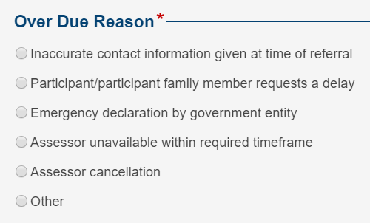
PIA Basics: Reports
Excuses/Late Assessments
PIA offers several choices to explain why an assessment might be completed outside the required timeframe.
When using "Inaccurate Contact information given at time of referral," we need to be able to verify whether information was changed in the change history or in the Case Management section, whether the OU was transferred. If you indicate that a FED is late due to being unable to reach the consumer, the tracking form needs to be attached to PIA and/or the Mosley vs. Alexander letter.
When using “Other,” assessors must include a substantive comment to explain why the assessment was overdue. “Other” should not be selected if the late reason fits one of the already available responses.
If the assessment was submitted late due to a PIA interface delay or glitch, the assessor should select “Other” and type in PIA Error. OLTL excludes these from AWP’s timeliness/performance measures.
Keep in mind that Assessor Unavailable Within Required Timeframe, Assessor Cancellation, or any IT issue are unacceptable since agencies must have backup plans.

Slide 34
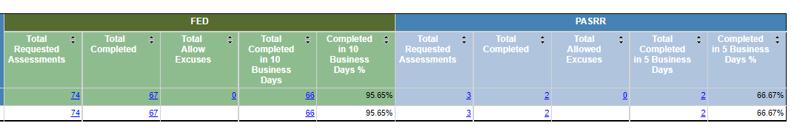
PIA Basics: Reports
Monthly Invoices – FED and PASRR
The FED and PASRR Completion Summary Report shows the total number of FED and PASRR assessments completed within the specified dates.
Open the FED and PASRR Completion Summary Report.
  Enter the start date of the month
  Enter the end date of the month
  Hit the View Report button
  Use the figures in the Total Completed columns for your invoice.
In this example, the AAA completed 67 FEDs and 2 PASRRs during the selected dates.
The totals columns contain a hyperlink. When clicked, it will expand to include details such as the person’s name, PIA ID, requested date, due date, completion/withdrawn date, status, and late excuses.

Slide 35

PIA Basics: Reports
Monthly Invoices – Desk Reviews
For invoice purposes, please use the Desk Review Detail Report and filter it according to the instructions below. This will ensure that all desk reviews completed by your AAA are captured.
Open the Desk Review Detail Report.
  Backdate the report by a few months. For example, if you are doing your invoice for May 2023, use the dates 3/1/2023 to 5/31/2023.
  Export the report to Excel.
  Open the Excel report and filter these two columns.
    Under Completion/Withdraw Date, select May.
    Under Status, select the boxes that state MDR Completed, MDR Requested, and Submitted. Exclude any that were Withdrawn. Hit Ok.
  Now look at the bottom left corner of your report to find the number of desk reviews to include on your invoice. In this example, the total would be 514.
*See Desk Review Detail Report Quick Reference Guide on the AWP website for detailed instructions.

Slide 36
PIA Basics: Reports
Monthly Invoices (Continued)
Monthly invoices must be submitted using AWP’s Invoice Template and signed electronically by any authorized representative of your AAA. If your AAA completed any appeals during the month, the Appeal Tracking Sheet must accompany your invoice.
Invoices are due to AWP no later than the 5th business day of the following month and should be emailed to fedbilling@agingwellpa.org. Be sure to copy your QCSS on the email.
If there are discrepancies between the invoice and PIA report numbers, you must explain and include the PIA IDs (duplicates, errors, etc.)
Your QCSS will make the final determination when approving your invoice for payment.

Slide 37
PIA Basics: Reports
Quality Assurance/Self-Monitoring
It is imperative for supervisors to regularly use the reports in PIA to perform self-monitoring activities and diagnose areas where improvements may be needed. A few benefits of self-monitoring include the following:
  Maintaining FED integrity and Operational Performance Standards (the monthly OPS report AWP sends to OLTL).
  Ensuring timeframes are met for FED and PASRR completion.
  Identifying issues and addressing trends or patterns.
  Aiding in contingency planning.
  Identifying assessor skill or training gaps.
A Reports Quick Reference Guide is available on the Aging Well website to supplement this information.
The following slides provide a list of reports and a description of how each report can be used for self-monitoring:

Slide 38
PIA Basics: Reports
Quality Assurance/Self-Monitoring (Continued)
Applicant Applied or FED Completion Summary is used to:
  Monitor the status of IEB referrals and direct from community referrals.
  Calculate the number of FEDs completed by your AAA.
  See IEB Referrals Quick Reference Guide on the Aging Well website.
FED and PASRR Completion Detail Report is used to:
  Monitor the status of pending, in progress, withdrawn, and completed FEDs and PASRRs.
  Calculate the number of PASRRs completed by your AAA.

Slide 39
PIA Basics: Reports
Quality Assurance/Self-Monitoring (Continued)
FED Excuse Detail Report
  Used to monitor late FEDs and ensure allowable late reasons are used.
PASRR Excuse Detail Report
  Used to monitor when and why PASRRs are being recorded as late.
The Excuse Reports provide an opportunity to discuss with your assessors the reasons why FEDs and PASSRs are not being completed on time.

Slide 40
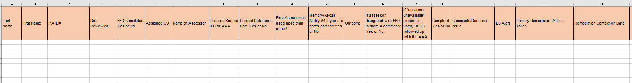
PIA Basics: Reports
Quality Assurance/Self-Monitoring (Continued)
Aging Well shared the QCSS team’s template to review and measure the OPS FED standards. We encourage you to use the same template to self-monitor your assessors’ performance with meeting the standards. If you do not have a copy of the template shown below, please get in touch with your QCSS.
The items reviewed on the OPS for compliance include:
Reference Date
First Assessment
Memory/Recall Cognition Question #4 Comment
Disagree Comment
Late Excuses/Timeframes
  For quality assurance purposes, you must also ensure the following:
  The IEB was alerted of all initial enrollment FEDs with the program type HCBS.
  Assessors are not using the “LIFE Program” or “Personal Care” program types.

Slide 41
PIA Basics: Reports
Quality Assurance/Self-Monitoring Remediation
After conducting self-monitoring activities, please remember to email your QCSS your list of errors. The supervisor or assessor should attach a brief note of correction to the profile to explain the error and the remediation action taken.
If a FED with an error or non-compliance is pulled for the monthly OLTL OPS report sample and AWP confirms that your AAA already identified and addressed it through self-monitoring, AWP can exclude it from the report. This helps improve your agency and AWP’s overall compliance with FED standards.

Slide 42
Desk Reviews
It is essential for supervisors to have a strong understanding of the desk review criteria and process.
As a part of the redetermination of clinical eligibility for individuals receiving long-term supports & services through CHC, desk reviews must be done every year. They must also be done when an individual’s level of care changes from NFCE to NFI.
Desk reviews are completed by comparing two sets of FED data in PIA.
For your reference, multiple desk review job aides are posted on the AWP website, such as the Desk Review Training, Flow Chart, Cheat Sheet, Priority Desk Review Template, Quick Reference Guides, Practice Scenarios, and more.
If you have questions regarding the desk review criteria or process, please get in touch with your QCSS for additional assistance. The AWP Team is here to support you and is willing to meet with you individually!

Slide 43
Desk Review: Alerts
Desk Review Alerts must be carefully managed and reviewed to ensure none are missed. How you choose to manage your AAA’s alerts is an agency decision. We recommend using whichever process works best for you.
  The Desk Review Alert Process (pdf) on the AWP website outlines some best practices and suggestions for handling alert notifications.
We highly encourage you to export your agency’s alerts to an Excel document. Exporting to Excel allows you to manipulate and save the data. We’ve created a quick reference for exporting alerts, too!
  Please see the Desk Review Alert – Exporting to Excel Quick Reference (pdf) on our AWP website for detailed instructions.

Slide 44
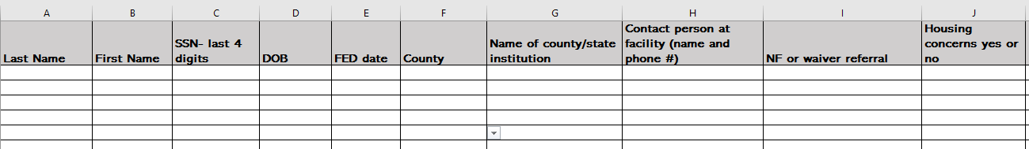
Correctional Facility FEDs
Individuals in need of long-term care who are released from prison often face unique challenges and obstacles, such as locating housing options or nursing homes. OLTL has asked for Aging Well’s assistance with identifying incarcerated individuals applying for either HCBS or nursing facility placements upon release.
If you receive a FED request from a correctional institution for an HCBS or nursing facility applicant, please complete the Template for AAA Correctional Institution FED Assessment Spreadsheet and email it to your QCSS immediately following the submission of the FED in PIA.
* Please get in touch with your QCSS for a copy of the Correctional Institution FED Template if needed.

Slide 45
Assessment Staff & PIA Users
New Hire Process & LMS Access
When you have a new assessor to train, please email your QCSS to obtain a copy of the New Hire Checklist and the Management Directive Form and gain access to AWP’s Learning Management System for your staff. The AWP LMS site is https://agingwellpa.litmos.com.
Your QCSS will need the following information to create your staff’s AWP LMS account:
  Full Name
  Email Address
After your QCSS creates the account:
  Staff will receive an email invitation with the link to the LMS. Instruct staff to open the link immediately. It will expire within 24 hours. The LMS operates best when using the Google Chrome browser.
  When logging in, their user name is their email address.
  They will be prompted to create a password upon their first login.
It is important to note that the AWP LMS differs from the PDA LMS.

Slide 46
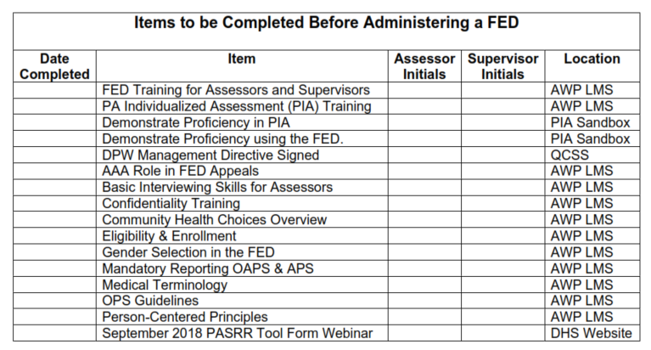
Assessment Staff & PIA Users
New Hire Checklist
All new assessors must complete the requirements on the New Hire Checklist before being granted access to PIA to conduct FEDs. Please make sure every area is completed.

Slide 47
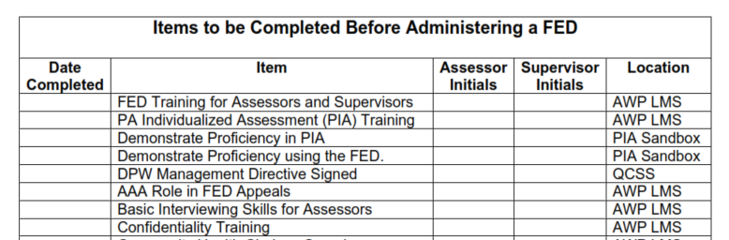
Assessment Staff & PIA Users
New Hire Checklist
Demonstrating the ability to navigate PIA and complete a FED should be done in the PIA Sandbox and NOT in the live PIA database.
The PIA Sandbox can be accessed at https://pa-assessment-uat-sso.eltss.org.
Username: training
Password: Train12345
Detailed instructions for logging into the Sandbox for the first time are available from your QCSS.

Slide 48
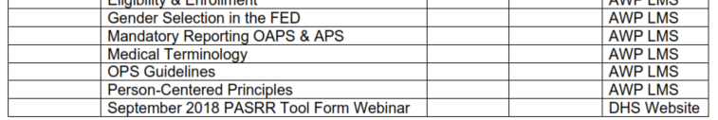
Assessment Staff & PIA Users
New Hire Checklist
Here is how to access the September 2018 PASRR Tool Form Webinar:
Go to: https://www.dhs.pa.gov/providers/Providers/Pages/PASRR-Process.aspx and scroll to resources. It has the PASRR resources, training handouts, and the webinar link.
YouTube of the recorded webinar - https://www.youtube.com/watch?v=SusAiTz5sF0&feature=youtu.be

Slide 49
Assessment Staff & PIA Users
New Hire Checklist: Requesting PIA Access
You QCSS will need the following before PIA access can be granted:
A copy of the completed New Hire Checklist initialed by the assessor and supervisor. This serves as confirmation that the assessor has met the initial certification requirements.
A signed copy of the Management Directive Form- Enclosure 3 Page.
The access role(s) staff needs (Assessor or Supervisor).
If applicable, any existing b-accounts staff currently use to access other Commonwealth databases.

Slide 50
Assessment Staff & PIA Users
PIA Access
After your new assessor receives a b-account, you may need to show them how to enter PIA for the first time or share AWP’s Accessing Live PIA Instructions. If unable to log in, instruct the assessor to call the Helpdesk at 1-800-281-5340 for a temporary password.
PIA users are highly encouraged to set up their security questions under the Self-Service section for business partners on the Keystone Key page. This will allow them to change their password easily in the future.
If role changes are needed later due to staff promotion or different duties, contact your QCSS. Your QCSS will verify that staff completed the appropriate training before allowing other PIA access.

Slide 51
Assessment Staff & PIA Users
It is important to note:
All primary and backup assessors must fully complete the New Hire Checklist requirements. This includes all supervisors who may need to submit a FED on behalf of an assessor who is suddenly out or having IT issues.
Not all assessment staff need to become certified.
A staff’s role in PIA determines their training requirements. For instance, staff members doing Intake/I&R, Administrative, or Fiscal tasks only need to complete the PIA modules relevant to their roles and responsibilities in PIA. Clerical staff doing only desk reviews also do not need to be certified.

Slide 52
Assessment Staff & PIA Users
Recertification
All assessors and supervisors with the potential to touch a FED in PIA (both primary and backup) must complete three additional courses in the AWP LMS Ongoing Professional Development Learning Path each year by their annual due date to maintain their certification.
AWP realizes some assessors completed more than three courses in the LMS, and others completed them all in the previous year. If this situation applies, please ensure staff repeat three courses as a refresher. This will reset the completion dates in the LMS to the current year and allow AWP to verify that the recertification requirements were met.
Staff who do not complete three courses by their due date month risk being deactivated in the PIA system.

Slide 53
At the beginning of the year, your QCSS will provide you with a list of active PIA users for verification. The list will include the assessors’ annual recertification due dates. It is the supervisor’s responsibility to track their assessment staff’s recertification dates.
Assessment Staff & PIA Users
Recertification
Assessors need to email their QCSS to have their AWP LMS accounts reactivated during the month of their due date. If your QCSS is unavailable, you may email your backup QCSS for assistance.
* All LMS accounts with no activity are deactivated after 30 days.

Slide 54
Assessment Staff & PIA Users
Deactivating Staff
When staff leave employment or transfer to a different department and no longer need access to PIA:
Email your QCSS the name of the staff.
Inform your QCSS whether the staff needs to be deactivated in the BP-ID Manager (meaning they will no longer need to access Commonwealth databases).
Unassign the staff from all consumers in the PIA Assignments Tab before requesting deactivation. If you do not, OLTL will not be able to deactivate them from all systems.
Please do not attempt to deactivate staff in PIA if you have the OU Admin role. Your QCSS and OLTL will handle everything!

Slide 55
Assessment Staff & PIA Users
Common IT Issues
If you or your staff experience an IT issue, please refer to the Common IT Issues document posted on the Aging Well website under the AWP Resources for AAAs tab. The document explains how to troubleshoot and resolve the most common PIA IT issues.
If you cannot self-resolve the problem after reviewing the Common IT Issues document, then reach out to your QCSS for further assistance
Helpful Hint: PIA passwords cannot contain a real word or a year.

Slide 56
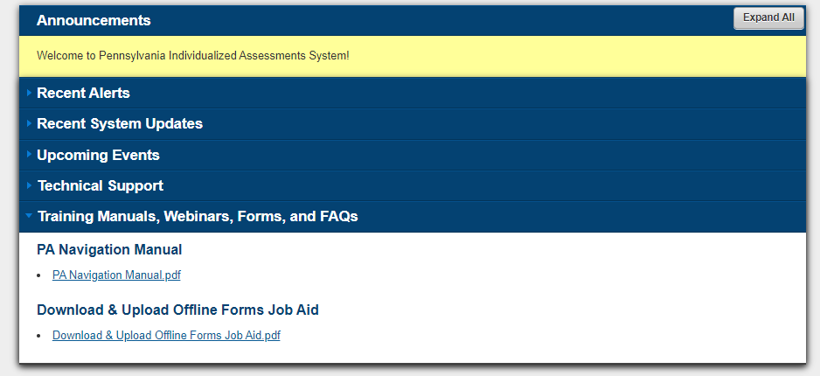
Assessment Staff & PIA Users
PIA Navigation Manual
FEI Systems published a PIA Navigation Manual to provide detailed steps to complete all processes associated with the PIA system. The guide is organized by primary topic areas that follow workflows.
The Manual can be easily downloaded from the PIA Home Page for quick reference.

Slide 57
Regional Conference Calls
The QCSS team facilitates monthly regional conference calls.
Representation from each AAA is required on the calls.
The AAA representative is responsible for sharing all updates and information with their assessment unit.
Keep in mind that not all AWP updates are shared in writing. Therefore, your AAA’s participation in the regional conference calls is essential.
Your QCSS will share the TEAMS invite and agenda before the scheduled meetings. You are encouraged to send any specific questions or requested agenda topics to your QCSS in advance.
If you cannot participate, please ensure you have a representative on the call or contact your QCSS to be added to another QCSS regional call invite that week.

Slide 58

AWP Contacts & Questions
One of the primary roles of your Regional AWP QCSS is to provide SUPPORT to the AAAs.
The Aging Well team respectfully asks that you contact AWP FIRST if you seek clarification or have questions regarding assessments and NFI disenrollment.
Aging Well is the assessment entity contracted with OLTL and is responsible for providing all oversight and clarification to the AAAs.
Emailing OLTL, PDA, the IEB, or other organizations first and copying us on the email is not an acceptable process. Please do not go above AWP staff. This type of reaction to changes or concerns does not serve us well or support our goal of being seen as reliable, capable, and outcome-oriented.
All assessment related questions or larger systemic issues should be brought to AWP or P4A first. Please do not contact the IEB, PDA or OLTL. They will direct you back to AWP.

Slide 59
AWP Contacts & Questions
Contact Cheat Sheet
Unassigned Organizational Units: aaarequests@agingwellpa.org
Medical Director Review Requests: aaarequests@agingwellpa.org
AWP LMS Training Access: QCSS
FED Related Questions: QCSS
NFI Disenrollment Questions: QCSS
Demographic/Merge Profile Update in PIA: QCSS
Desk Review Questions: QCSS
FED Invoice Questions: QCSS
Submission of Monthly Invoices: fedbilling@agingwellpa.org and cc your QCSS
Withdrawal of FED: IEB contact: IEB-PAEncryptionBox@maximus.com
IEB Inquiries for Applicant Specific Contact Information: PAIEBStakeholderInquiries@maximus.com
PASRR Program Office Contact List: https://www.dhs.pa.gov/providers/Providers/Pages/PASRR-Process.aspx
PIA Help Desk 1-800-251-5340 (PIA Password Reset-Option 2- Business Partner)
Desk Review/NH Appeal Stipulated Agreements: QCSS and CC Carleen Longo (clongo@agingwellpa.org)

Slide 60
AWP Primary Contact List
Courtney Drellich, QCSS Southeast Region ● cdrellich@agingwellpa.org ● Cell: 267-772-4713
Adams, Berks, Bucks, Chester, Cumberland, Dauphin, Delaware, Franklin, Huntingdon/Bedford/Fulton, Lancaster, Lebanon, Montgomery, Perry, and York Counties
Andrea Felicetta, QCSS Northeast Region ● afelicetta@agingwellpa.org ● Cell: 609-221-1068
BSST (Bradford, Susquehanna, Sullivan, &Tioga), Carbon, Columbia/Montour, Lackawanna, Lehigh, Luzerne/Wyoming, Monroe, Northampton, Northumberland, Pike, Potter, Schuylkill, Union/Snyder, and Wayne Counties
Sherry Hoffman, Senior QCSS Northwest Region ● shoffman@agingwellpa.org ● Cell: 814-203-6717
Active Aging (Crawford), Clarion, Experience, Inc. (Warren/Forest), Greater Erie Community Action Committee (Erie), Jefferson, Mercer, Office of Human Services (Cameron/Elk/McKean), Philadelphia, STEP (Lycoming/Clinton), and Venango Counties
Angela Yakoski, QCSS Southwest Region ● ayakoski@agingwellpa.org ● Cell: 570-855-8249
Aging Services, Inc. (Indiana), Allegheny, Armstrong, Beaver, Blair, Butler, Cambria, Centre, Clearfield, Lawrence, Mifflin/Juniata, Somerset, Southwestern PA (Washington/Fayette/Greene), and Westmoreland Counties.
Michelle Keck, Program Manager● mkeck@agingwellpa.org ● Cell: 717-816-9330
Rebecca May-Cole, Executive Director ● rmaycole@p4a.org ● 717-856-3000

Slide 61
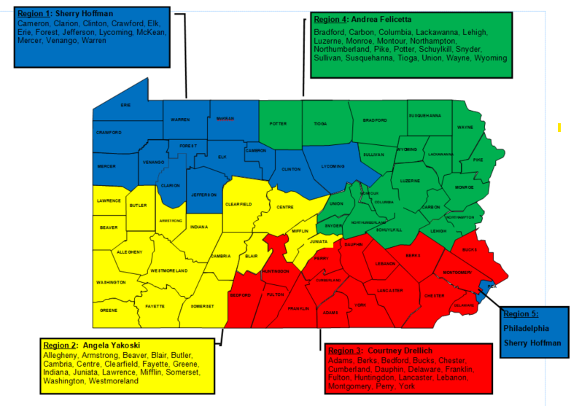
AWP QCSS Coverage Map

Slide 62
AWP Backup Contact List
When your primary QCSS is unavailable, you may reach out to another QCSS for immediate assistance. The designated backup QCSS for your agency is listed below:
Courtney Drellich ● cdrellich@agingwellpa.org ● Cell: 267-772-4713
Beaver, BSST, Cambria, Carbon, Experience, Inc., GECAC, Jefferson, Luzerne/Wyoming, Lehigh, Mercer, Mifflin/Juniata, Pike, Southwestern PA, Westmoreland
Andrea Felicetta ● afelicetta@agingwellpa.org ● Cell: 609-221-1068
Allegheny, Berks, Blair, Chester, Dauphin, Franklin, Montgomery, PCA, Somerset
Sherry Hoffman ● shoffman@agingwellpa.org ● Cell: 814-203-6717
Adams, Aging Services, Inc., Armstrong, Butler, Centre, Clearfield, Columbia/Montour, Cumberland, Delaware, Lackawanna, Lawrence, Potter, Schuylkill, Union/Snyder, York
Angela Yakoski ● ayakoski@agingwellpa.org ● Cell: 570-855-8249
Active Aging, Bucks, Clarion, Huntingdon/Bedford/Fulton, Lancaster, Lebanon, Monroe, Northampton, Northumberland, OHS, Perry, STEP, Venango, Wayne
Notes:
.

Slide 63

Questions?

